Slide 1
LOAN 2 wheel CREDIT SCORE PREDICTION

Slide 2




PROFILE
085704928504
linkedin.com/in/arenggadean
https://github.com/MBAHTAWOONS
Nama | Arengga Dean Prayoga, S.pt
Age | 25 Years (1998)
Occupation | Python User
Education Background
Bachelor degrees of Animal Husbandry (Brawijaya University, 2021)
Data Science Bootcamp (Dibimbing.ID, September 2023)

Slide 3



DAFTAR SLIDE
Business Understanding
Data Preparation
Data Visualization
Feature Encoding
Modeling & Results

Slide 4

Business Understanding

Slide 5








BUSINESS UNDERSTANDING
FINANCE LOAN
People’s behaviour needs money to get instant needs. The solution is a loan.
Financial companies need trusted customer
They build scores on customer ability called credit score

Slide 6
Cibil (INDIA) & fico (US) credit score
### FICO credit score (US) mybanktracker.com
800-850 Excellent:
Qualify easily for most loans and lines of credit with low interest rates and favorable terms.
740-799 Good:
Valuable benefits come in the form of loans and lines of credit with comprehensive perks and low interest rates.
670-739 Average/Fair:
Eligible for many traditional loans, but the interest rates and terms may not be the best.
580-669 Bad:
May be able to qualify for some loans and lines of credit, but the interest rates are likely to be high.
300-580 Very Bad:
Extremely difficult to obtain traditional loans and line of credit. Advised to use secured credit cards and loans to help rebuild credit.
### CIBIL score (india) source IIFL finance.com
750 – Above Excellent:
These Individuals are likely to have a high likelihood of loan approval and can access loans and credit at favourable terms, including lower interest rates.
700 – 749 Good:
This scoring range also signifies a strong credit profile, and individuals within this range are generally considered reliable borrowers by lenders.
650 to 699 Fair:
Individuals with fair credit scores can have access to credit, but they might face slightly higher interest rates or more stringent lending conditions than those with higher scores.
Below 650 Poor :
They may face challenges in obtaining credit or loans as lenders may be more cautious due to the perceived higher credit risk.

Slide 7
WHAT PURPOSE TO PREDICT CREDIT SCORE?
Minimize loss risk
Determining interest rate
Loan decision

Slide 8
Data Preparation

Slide 9
DATASET
INDIA TWO WHEELS CREDIT SCORE DATASET
15 FEATURE & 1 TARGET
CUSTOMER PROFILE, FINANCIAL PROFILE, LOAN HISTORY PROFILE
TARGET CONTINUOUS? CREDIT SCORE RANGE 350 – 850.
in Indonesia generally credit score range 250-900 (idscore.id). so here more suitable use famous FICOcredit score and local credit score CIBIL
Metrics :
# MSE, RMSE for same unit scale according to feature
# The model predicts customer credit score, for us to make a decision on which classification is customer based on CIBIL SCORE or FICO CREDIT SCORE

Slide 10
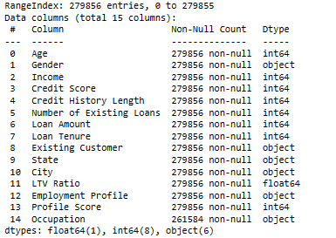
Feature
Drop One feature Profile score because unknown value based (no information on how to get the value)
Encode + 1 feature based on the existing feature:
Property Value:
Description : Value the reason customer want to loan (two wheel’s value)
type : float
Build by : Loan Amount / (LTV Ratio / 100 )
DROPPED

Slide 11
Data cLEANING
Duplicated Handling :
279.856 entries data
Problem : Duplicated records (All columns subset) = 100.814 rows
Handle : Drop into 179.042 rows
Missing Value Handling :
Feature : Occupation (11.690 rows/ 6%)
Problem : Missing value are based on Unemployed customer (Employments profile)
Handle : Change the value to “ None”

Slide 12
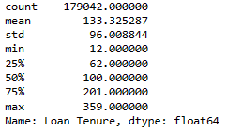
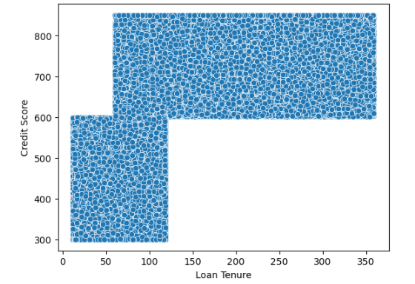
cleaning
Loan tenure :
Weird data, two wheeler loan tenure max up to 359 months (30 years)in concept, for two wheeler loan in India its really weird.
#checked from bankbazaar.com platform (india) for two wheeler loan tenure from official national and private bank there no bank provide loan tenure more than 7 years.
# emi calculator there is only up to 84 month
Length : 107.973 rows (60,3% from total)
Handle : Change Value Continuous to Discrete. (below 60 months and above 60 months)
Divide Here

Slide 13
data visualization

Slide 14
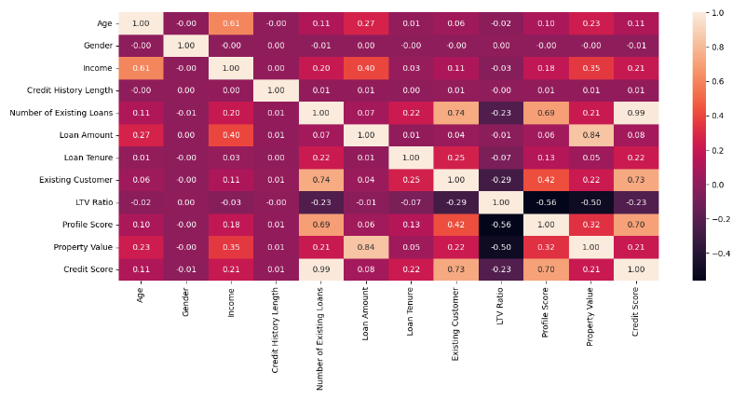
PEARSON HEATMAP
Less contribution to model

Slide 15
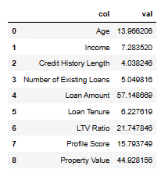
Variance influence factor ( VIF) MULTICOLINEARITY
Value that shows more than 10 are multicollinearity:
Multicolinearity feature are Age, loan amount, LTV ratio, Profile score, Property value,Income
Handle : Drop and Feature Engineering

Slide 16
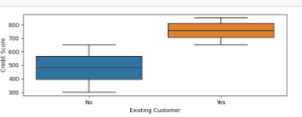
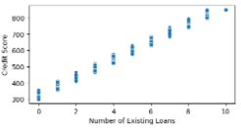
MULTIVARIATE
EXISTING CUSTOMER VS CREDIT SCORE
NUMBER OF EXISTING LOAN VS CREDIT SCORE
HIGH CREDIT SCORE MORE IN EXISTING CUSTOMER
MORE HIGH CREDIT SCORE MORE COUNT NUMBER EXISTING LOAN

Slide 17
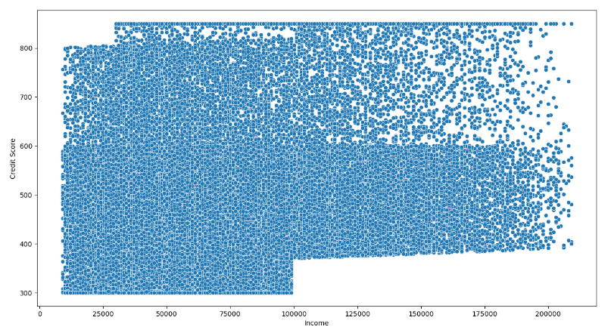
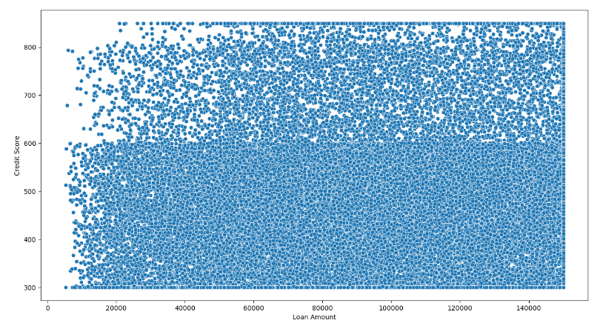
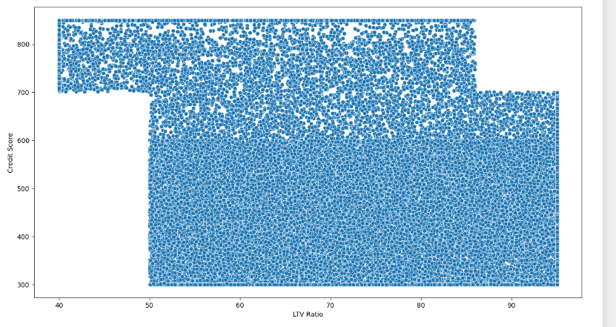
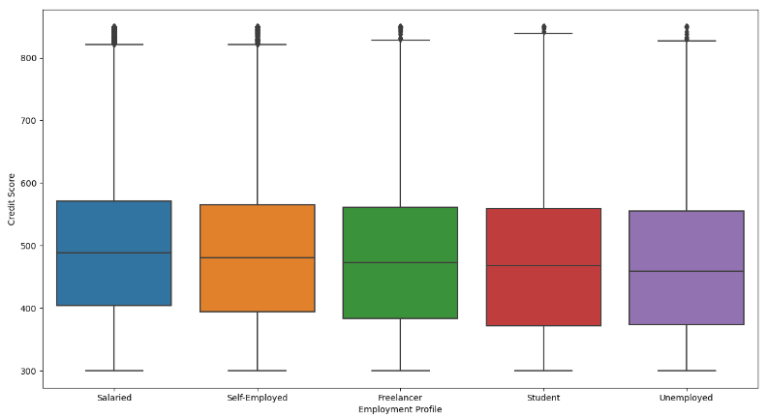
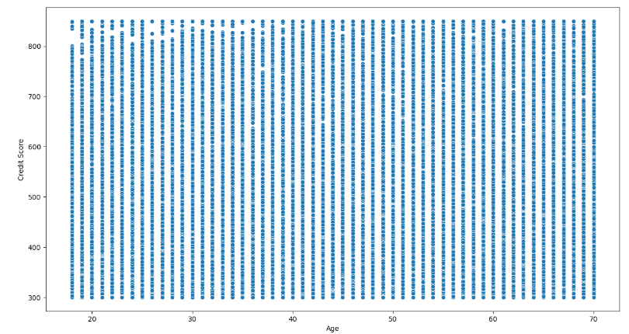
OTHER FEATURES USED VS CREDIT SCORE
Income to Credit Score
Loan amount to Credit Score
LTV Ratio to Credit Score
Employment Profile
Age

Slide 18
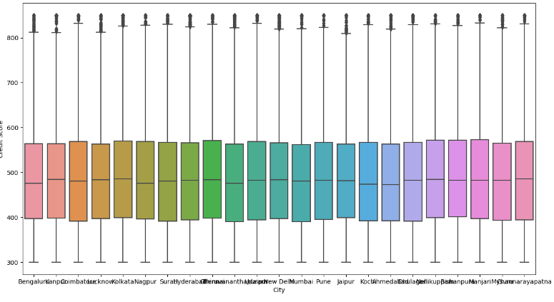
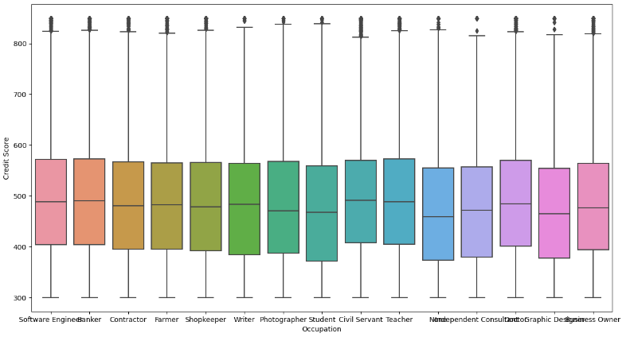
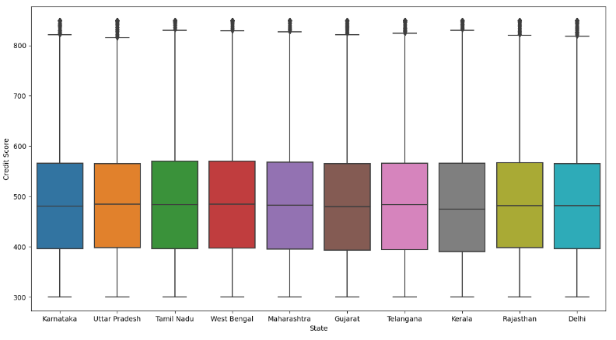
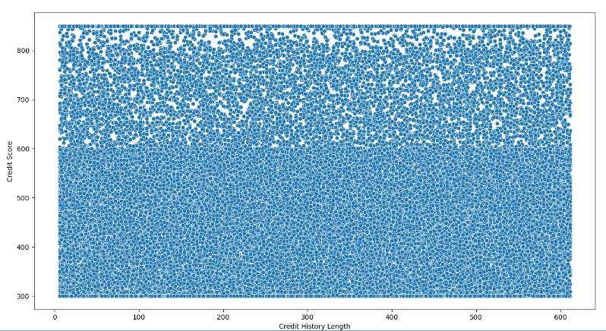
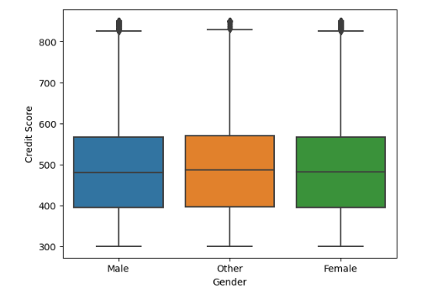
DROPPED FEATURES
City to Credit Score
Occupation to Credit Score
State to Credit Score
Drop reason :
THERE IS NO DIFFERENCE IN FEATURE BETWEEN EACH VALUE TO TARGET
Credit History Length
Gender

Slide 19
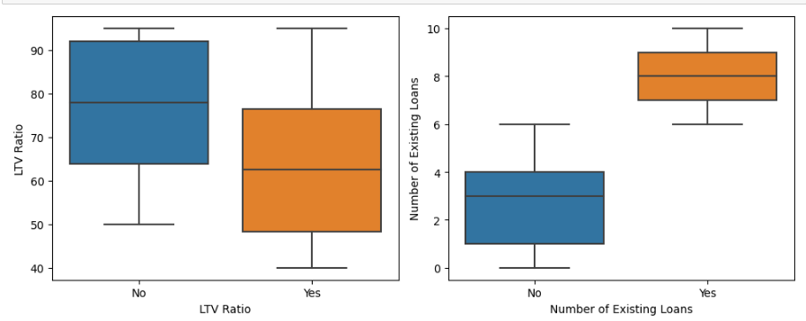
EDA (EXPLORATORY DATA ANALYSIS)
Existing Customer (High influence to credit score)
Existing customers,mostly in LTV ratio with below 75 % priority below 65 %
Existing customers, mostly customers that have a number of existing loans more than 7 up to 9 count

Slide 20
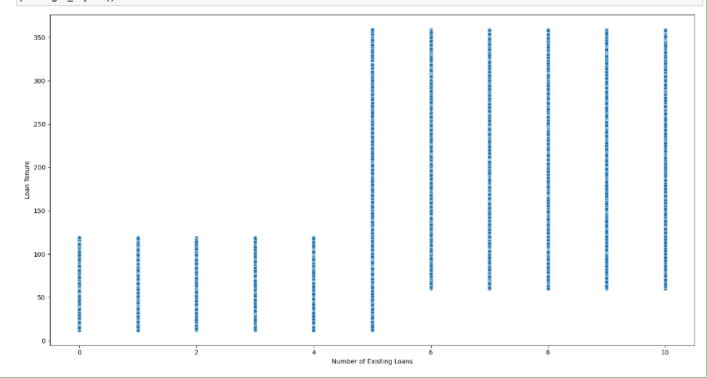
EDA (EXPLORATORY DATA ANALYSIS)
Number of Existing Loans (High influence to credit score)
Customer that Have Number of Existing Loans more than 7 have loan tenure more than 60 months (5 years)

Slide 21
FEATURE ENCODING

Slide 22
FEATURE ENCODING
Age:
There is Multicolinearity on Age to other feature.
Handle : Powers Transformation 3/2

Slide 23
Modeling & results

Slide 24
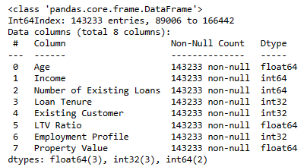
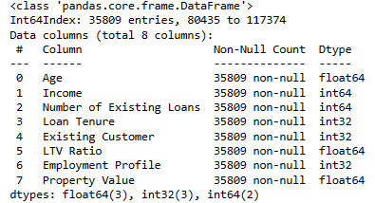
Feature used for model
TRAIN
TEST

Slide 25
results
MODEL | MSE | RMSE
Random Forest Regressor | 124.55 | 5.15
XGB Regressor | 203.58 | 13.78
LGBM Regressor | 208.58 | 14.29
Ridge | 284.16 | 16.85
Linear Regression | 284.16 | 16.85
Lasso | 284.16 | 16.85
T R A I N
Feature not used scaling because no impact for model results
For comparison between Model’s, gridsearchCV used with Kfold =5
MODEL | MSE | RMSE
Random Forest Regressor | 104.35 | 10.21
XGB Regressor | 224.44 | 14.24
LGBM Regressor | 232.02 | 14.45
Ridge | 281.31 | 16.84
Linear Regression | 281.31 | 16.84
Lasso | 283.75 | 16.86
T E S T
Random Forest Regressor have best score in MSE,RMSE, and also R square, with +param max_depth = 30 for hope model sustain.

Slide 26
FINAL MODEL
Params = Max Depth(30)
TRAIN DATA
RANDOM FOREST REGRESSOR | MSE: 26.59 | RMSE:5.15
TEST DATA
RANDOM FOREST REGRESSOR | MSE:104.35 | RMSE:10.21

Slide 27
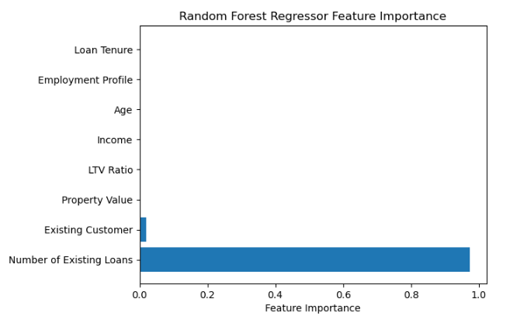
FEATURE IMPORTANCES
Existing customers and Number of Existing loans are very important in credit scoring

Slide 28
Business recomendation
Financial Company Existing Customer has a big influence on Credit scoring so Financial company can do marketing plan for their Existing customer because it’s more trusted.
For new customer we can focus on customer that have good credit score and LTV ratio below than 75 % priority 65 %
The number of existing loans has a big influence on Credit Score, Maybe it’s because Customer who has more loans can establish and manage their money for loan payment. So Finance company can do marketing loans for people who have another loan but with a limit of around 10 loan count.
Financial Companies can do marketing with loan tenure more than 5 years, that have information are customers who have number of existing loans 7-9 count.
Model can predict two wheels loan CREDIT SCORE with RMSE 10.21, so for the predict about credit score mistakes is around 10.21 unit score for the scale 350 -850 credit score.

Slide 29
Notebook :
https://github.com/MBAHTAWOONS/TWO-WHEELS-CREDIT-SCORE-PREDICTION.git
Demo:
Creditscoretwowheeler - a Hugging Face Space by MbahTawoons
THANKYOU

